Slide 1

1
RFID BASED ATTENDANCE SYSTEM

Slide 2
ABSTRACT
The main functionality of the project id to identify/attendance of the user who needs to access it through RFID.
For this purpose, the authorized person is given an RFID card.
This card contains an integrated circuit that is used for storing, processing information through modulating and demodulating of the radio frequency signal that is being transmitted.
Thus, the data stored in the card is referred as the identification/attendance of the person.

Slide 3
ABSTRACT
Once, the person places the card in front of the RFID card reader, it reads the data and verifies it with that data present in the system and if it matches then it displays a message as valid entry and allows accessing the device or else displays invalid and denies the access/attendance.

Slide 4
PROPOSED SYSTEM
There are different technology available to store the data like adafruit, cloud computing and etc..
But here I have used an PLX DAQ software tool, which is inbuilt with an excel sheet
So if the RC522 receives the RFID , then the data will be stored in the excel sheet of PLX DAQ tool .
In my project there is no need of connecting internet to the system .
This method is very useful for schools and colleges

Slide 5
HARDWARE & SOFTWARE
Arduino uno
RC522
RFID tags
Bread Board and connecting wires
PLX DAQ tool. ( Parallax microcontroller data acquisition add on tool for Microsoft excel)

Slide 6
BLOCK DIAGRAM

Slide 7
Built the code in arduino ide
The receiver data will be stored in the excel sheet
Upload the code in Arduino board
Put the RFID tag in front of the receiver RC522
First detect the output through the serial monitor
Enable PLX DAQ with the Arduino
Then install the PLX DAQ software tool

Slide 8
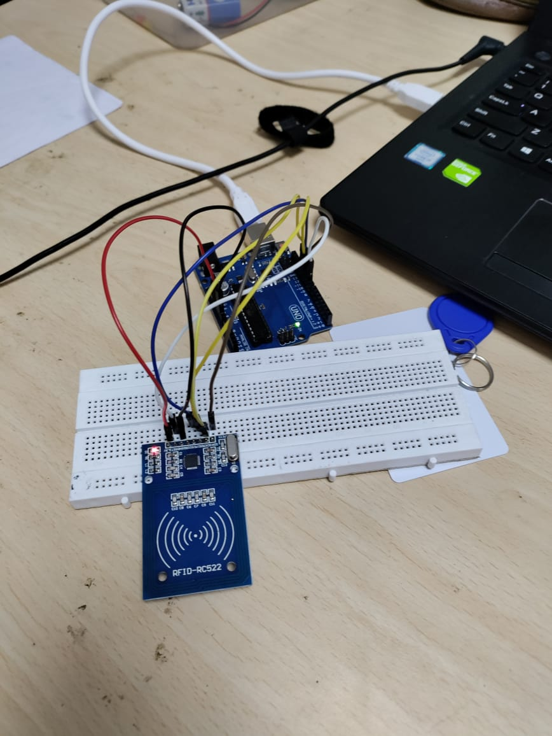
HARDWARE CONNECTION

Slide 9
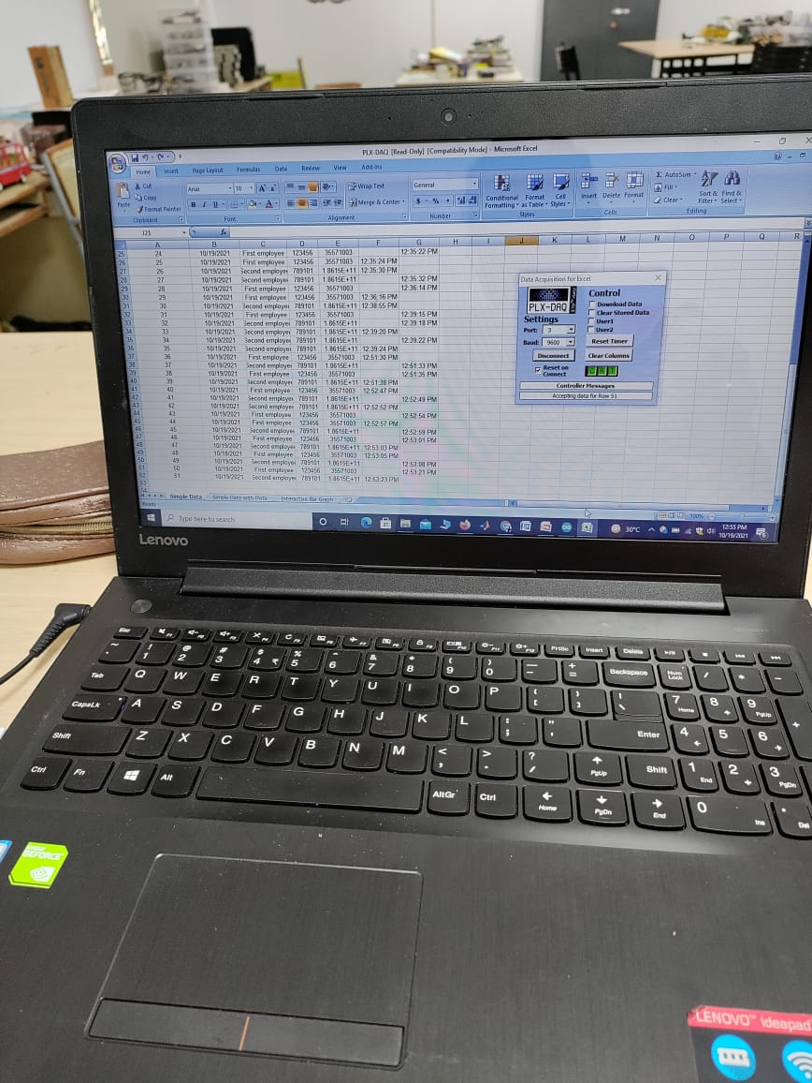
EXCEL OUTPUT

Slide 10
APPLICATIONS
RFID based attendance system can be used in educational institutions, industries, anywhere.
RFID is emerging technology and is used in applications where authentication is needed

Slide 11
ADVANTAGES
Proxy attendance can be caught.
Hard copy paper work of attendance is reduced.
Data can be stored for long time compare to attendance sheets.
This system is fully automated and it does not require any human interaction except setting the initial tie setting.
LCD and PC interface both are provided with RFID based attendance system. This gives benefit of viewing attendance on the spot on LCD or remotely from computer.

Slide 12
LIMITATIONS
RFID attendance system is secured, but there s a chance of misusing the cards. One person can give another person’s attendance if he/she had RFID card.
If the card was swiped for more than once, there is a chance of giving attendance for next days also if the code is not written properly.

Slide 13
FUTURE SCOPE
Range of RFID reader can be increased, so the reader can detect the tag from far distance.
RF TRANSRECEIVER module can be used for long distance communication to transfer data.
The transferred data can be saved and stored in computer as a database using specific software.
Timely attendance can be monitored i.e.time in and out can be barcoded using RTC(real time clock) and can be stored in the database.

Slide 14
FUTURE SCOPE
This attendance system’s database can be linked with college website and can be shared and monitored by the student’s parents.
We can send this data through internet to the user. So that user can access it remotely via internet.

Slide 15
THANK YOU

